Slide 1

Data Science Case Study
Customer Satisfaction
Prediction for
Rail Services
An End-to-End Data Science Case Study to Support Customer Retention
119K+ Records
EDA & ML
Customer Satisfaction Optimization

Slide 2
Business Context
Business Case
Challenge
Strategic Goals
A train company has collected customer feedback data on service ratings by post-service email request. The organization seeks to transform this raw data into actionable insights to drive strategic decision-making.
Improve Retention
Reduce main causes of dissatisfaction to increase repeat bookings
Targeted Promotions
Objective
Make promotions more efficient by targeting high-risk segments
Leverage data analysis and machine learning classification models to predict customer satisfaction and identify the most influential service variables that drive positive customer experiences.
Operational Insights
Help operations teams prioritize the right improvement actions
Caveat: a key business limitation intuition here is that service ratings are collected after the trip, and customers are not forced to submit them. As a result, rating-based features are informative but not consistently available for every customer.

Slide 3
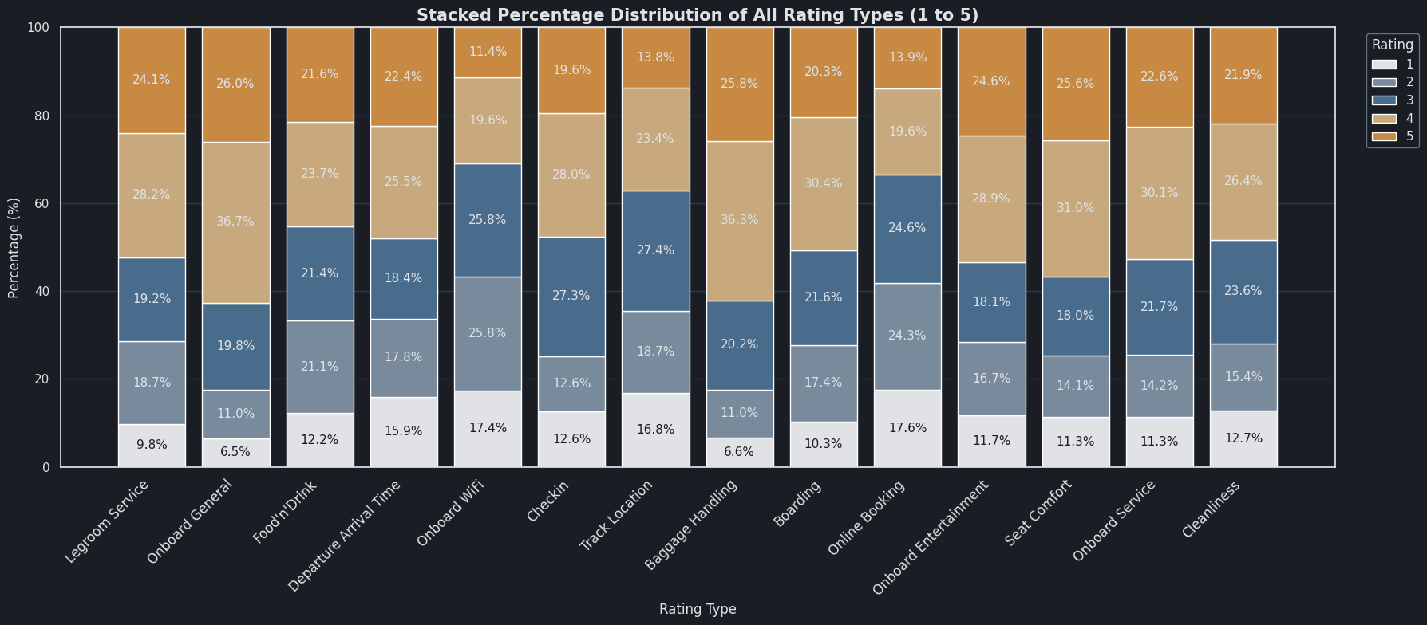
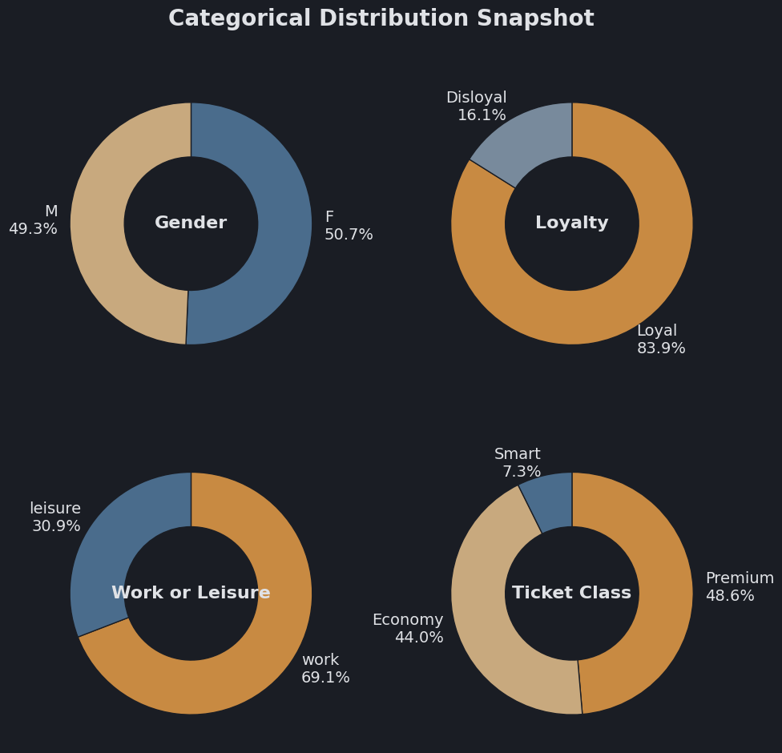
Data Foundation
The Dataset
119,567
25
363
Data Quality Status
Total Records
Features
Missing Values
Completeness
99.7%
Missing Values
Arrival Delay in Minutes
Feature Categories
Duplicate Records
0
Customer Info: Age, Gender, Loyalty, Purpose
Travel Details: Ticket Class, Distance, Delayes
Service Ratings (1-5 Stars): 14 features
Target: Satisfied (Y/N)
Data has to be treated to be ready for modelling
Satisfaction Distribution
56.7%
Satisfied (Y)
43.3%
Not Satisfied (N)

Slide 4
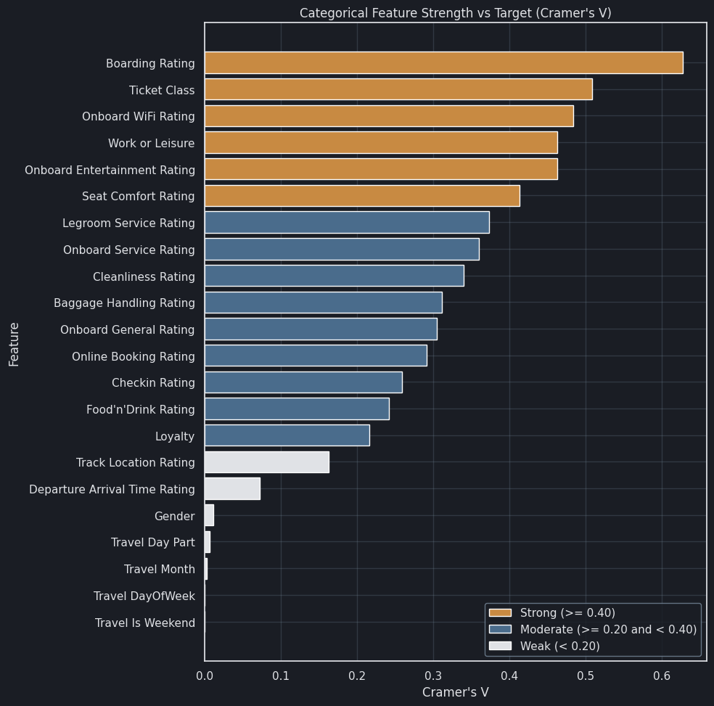
Exploratory Data Analysis
Feature Analysis
Cramer's V: Predictor Strength
Satisfaction Rate
Lowest 10 Categories
Cramer's V Interpretation
Association strength with Satisfaction (0 none, 1 perfect). <0.10 negligible, 0.10–0.30 weak, 0.30–0.50 moderate, >0.50 strong. Not directional.
Purpose : Leisure
0.08
Onboard Entert. : 1 ⭐
0.09
Boarding : 2 ⭐
0.11
Near Zero Cramer's V Values
Onboard Service : 1 ⭐
0.17
For Travel DayOfWeek / Travel Is Weekend, satisfaction rates are flat across days/weekends,
so these engineered calendar features carry no meaningful signal for predicting satisfaction.
Cleanliness : 1 ⭐
0.17
Legroom Service : 1 ⭐
0.17
Food and Drink : 1 ⭐
0.17
Ticket Class : Economy
0.17
Interesting Finding
Loyalty: Disloyal
0.18
Customer that rated the WiFi with 5 stars are satisfied 99% of the times.
Seat Comfort : 1 ⭐
0.19
Note: Service-experience ratings dominate predictive power, especially Boarding and WiFi. Lowest satisfaction concentrates in Leisure + Economy + Disloyal segments with 1★–2★ service scores.

Slide 5
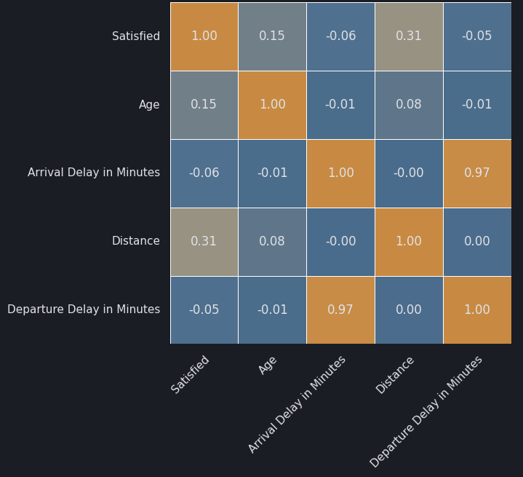
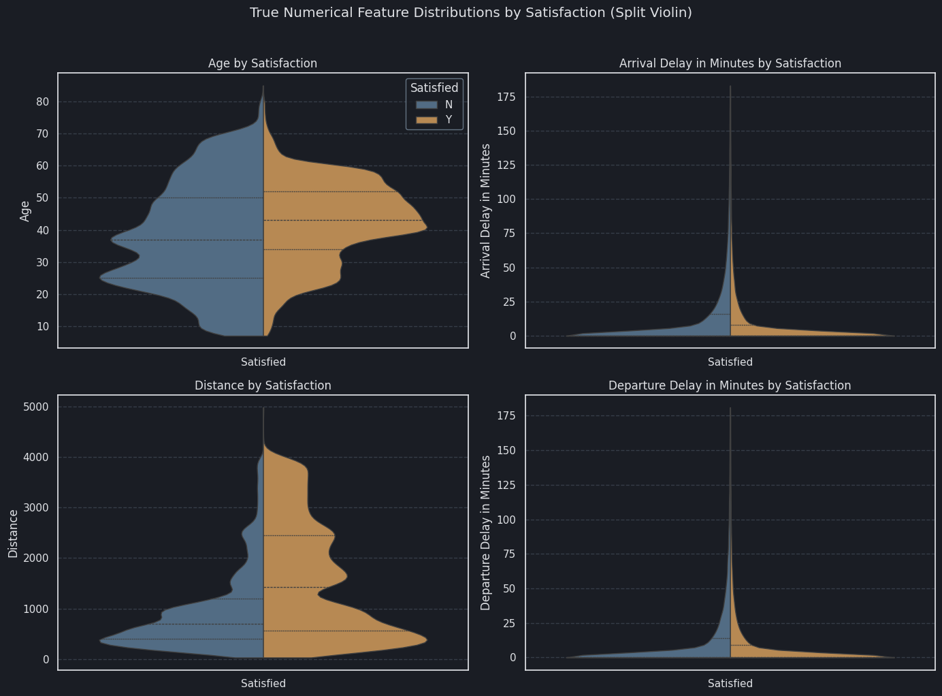
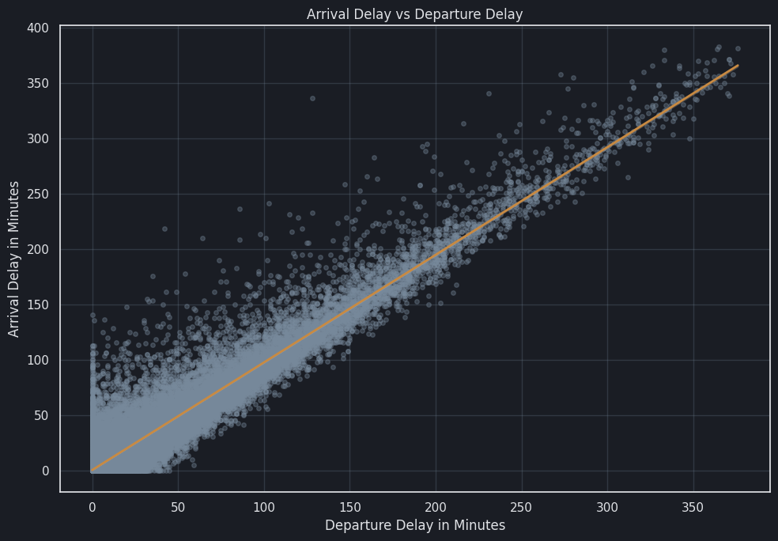
Exploratory Data Analysis
Linear Feature Analysis
Correlation Matrix: Numerical Features
Numerical Feature Satisfaction Distribution

Slide 6
Methodology
Modeling Process Structure
Preprocessing
Stratified Split
Models Pretesting
Data cleaning, encoding, feature engineering
65% Train / 15% Val / 20% Test
4 algorithms on validation set
Evaluation Metrics
Hyperparameter Tuning
Final Testing
Accuracy, Precision, Recall, F1, AUC
RandomizedSearchCV optimization
Unbiased performance on test set
Models Evaluated
Key Methodology Decisions
Random Forest
Decision Tree
Stratified split ensures balanced class distribution across all sets
Ensemble method
Interpretable
Cross-validation for robust hyperparameter selection
KNN
Logistic Regression
Test set held out until final evaluation to prevent data leakage
Instance-based
Linear baseline
Multiple metrics for comprehensive model assessment

Slide 7
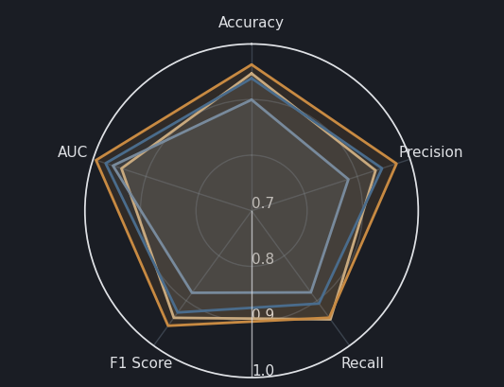
Model Performance
Pre-Tuning Results & Comparison
Model Performance Radar (Zoomed)
Validation Metrics Summary
Accuracy
Random Forest
96.1%
P: 97.1%
R: 93.7%
F1: 95.4%
AUC: 99.4%
Decision Tree
94.5%
P: 93.5%
R: 94.1%
F1: 93.8%
AUC: 94.4%
KNN
93.8%
P: 94.7%
R: 90.6%
F1: 92.6%
AUC: 97.5%
Logistic Regression
89.9%
P: 88.3%
R: 88.4%
F1: 88.3%
AUC: 96.3%
Key Finding: Random Forest dominates across all metrics with 96.1% accuracy and AUC of 99.4%, indicating strong discriminative power and robust performance. On the other hand, in this pre-selection of model training, Logistic Regression gets outperformed from the other more complex models.

Slide 8
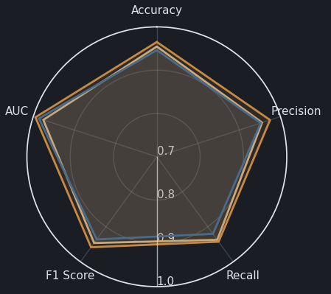
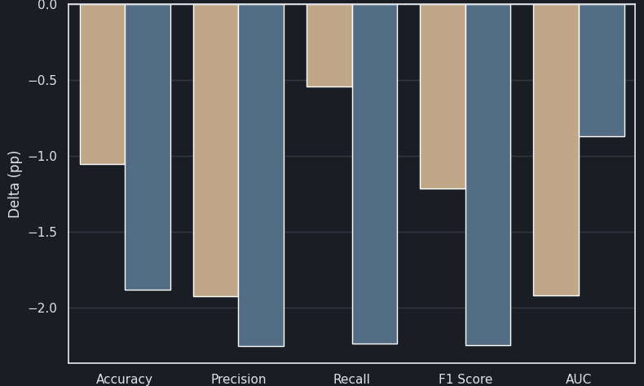
Final Evaluation
Tuned Test Results & Comparison
Test Performance Radar
Test Metrics Summary
Random Forest Point Percentage Delta
Accuracy
Random Forest
96.3%
P: 97.1%
R: 93.1%
F1: 95.6%
AUC: 99.4%
Decision Tree
95.2%
P: 95.6%
R: 93.1%
F1: 94.3%
AUC: 97.5%
K-Nearest Neighbors
94.3%
P: 94.7%
R: 94.6%
F1: 93.2%
AUC: 98.4%
Performance Analysis
Best Model
Generalization Concern
Validation-to-test deltas are very small, suggesting that the model probably didn’t overfit.
Random Forest maintains lead with 96.3% accuracy, though margin over the Decision Tree (95.2% -> -1.1%) is minimal.
Main risk is real-world drift (seasonality, policy/operations changes, survey-response bias) → monitor & retrain.

Slide 9
Extended Analysis
Limitations & Without Ratings Analysis
Limitations
Without Ratings Scenario
Missing Values
To ensure deployability in real operations, a complementary analysis was conducted: predicting satisfaction without using any post-trip rating features.
Only “Arrival Delay in Minutes” has missing values (363 rows ≈ 0.30%). It was imputed using a linear regression from Departure Delay to preserve consistency and retain records.
Uses only demographics, travel details, and service class
Rating Dependency
Enables pre-trip real-time predictions or when ratings are missing
Current models rely heavily on post-trip ratings, which may not be available in real-time prediction scenarios.
More practical for proactive customer retention
Distribution Shift
Research Question
Train/val/test come from the same historical sample, but production may shift over time. Add drift monitoring + periodic retraining.
Can we achieve a good enough performance without rating features? This tests whether satisfaction is predictable from customer profile and trip characteristics alone.

Slide 10
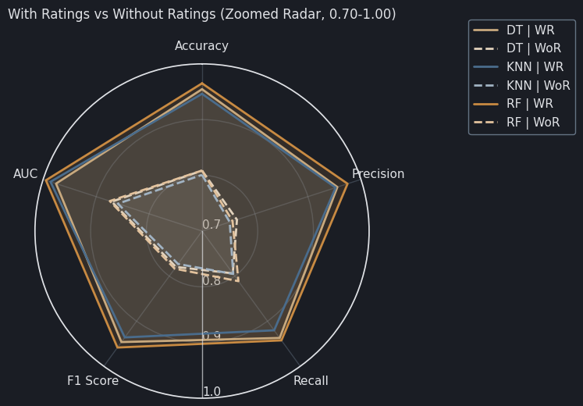
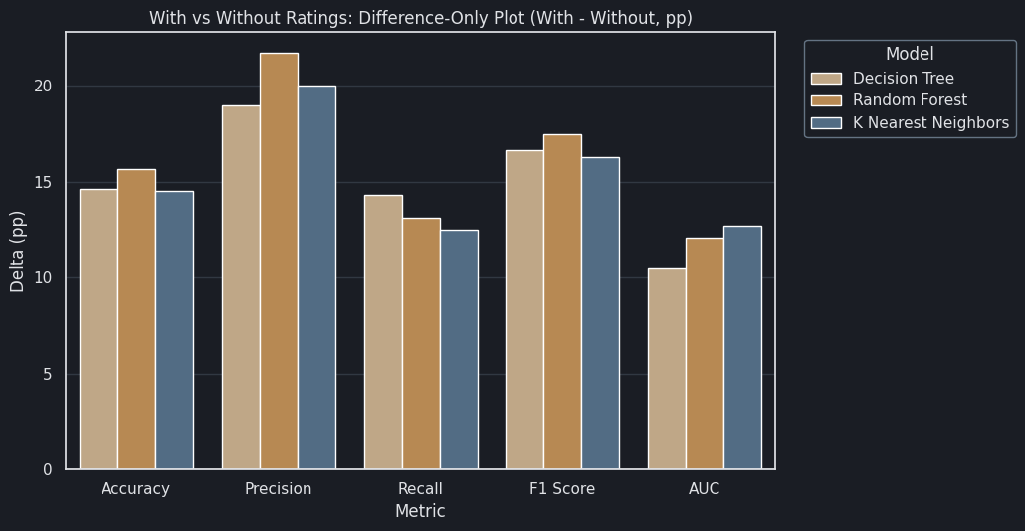
Alternative Pipeline Results
Without Ratings - Performance Comparison
With vs Without Ratings
Accuracy Shift With vs Without Rating
Performance Delta: With - Without Ratings
Random Forest
96.3% 81.1%
Decision Tree
95.2% 80.6%
K-Nearest Neighbors
94.3% 79.9%
Expected Metrics Drop
Why This Happens
Deployment Insight
Removing rating features lowered metrics by a considerable amount. This is the trade-off for a model usable when post-trip surveys are missing.
Ratings carry direct service-experience feedback, which is the strongest possible signal. Without ratings, the model relies on weaker proxies, so predictive power drops.
Use a two-pipeline setup: With-ratings → post-trip diagnosis & target recovery.
Without-ratings → scoring when ratings are missing.

Slide 11
Final Assessment
Conclusions & Recommendations
Key Findings
Business Call To Action
First focus on Boarding flow, WiFi reliability, Entertainment quality, Cleanliness, and Onboard service consistency.
1
Random Forest Best Overall
Achieved the best accuracy in both with and without ratings. Strongest and most consistent and versatile performer.
Use the with-ratings model for high-precision post-trip recovery and root-cause diagnosis, and use the no-ratings model for broad proactive coverage when surveys are missing.
2
Dissatisfaction is concentrated in clear service pain points
Biggest risk groups: Leisure, Economy, Disloyal customers, plus low scores in Boarding, WiFi, Entertainment, Cleanliness, Onboard Service, Food & Drink, Seat Comfort.
Build retention playbooks for Economy + Leisure + Disloyal passengers (service recovery vouchers, tailored offers, loyalty conversion campaigns)
3
Ratings Drive Peak Accuracy But Operations Need Two Pipelines
Future Improvements
Models with ratings clearly outperform (96.3% vs 81.1%). Since many customers don’t submit post-trip ratings, Deploy a two-model setup: with-ratings for post-trip diagnosis/recovery, and no-ratings for broad proactive coverage.
• Collect more diverse training data regarding customer behaviour (non-rating)
• Increase survey response rate to expand coverage of the higher-accuracy ratings pipeline
• Run A/B tests on model-driven interventions and measure retention uplift

Slide 12
Thanks for the attention!
Q&A

